Slide 1
IMAGE COMPRESSION
GVHD: Lê Thành Sách
SV:
1. Nguyễn Anh Minh 51001947
2. Nguyễn Xuân Thành 51003010
Notes:
1
1

Slide 2
Introduction
JPEG (Join Photographic Experts Group)
The JPEG specification document is divided into 4 part
  Requirements and Guidelines, Document number ITU-T T.81 or ISO/IEC 10918-1.
  Compliance testing, Document number ITU-T T.83 or ISO/IEC 10918-2.
  Extensions, Document number ITU-T T.84 or ISO/IEC 10918-3.
  Registration profile, tags, colour space,…, Document number ITU-T T.86 or ISO/IEC 10918-4.

Slide 3
Introduction
Jpeg have 4 modes of operation:
  Sequential DCT-based
  Progressive DCT-based
  Lossless
  Hierarchical

Slide 4
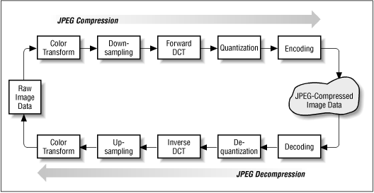
JPEG coding processing steps

Slide 5
EnCode

Slide 6
Encode processes
1/ Load Bitmap Image (BM) content (sizes, pixels) into buffer with padded sizes to the sizes which is a multiple of 8.
2/ Initialize: Quantize table; Huffman code table, coefficient coding categories for DC & AC coefficient.
Convert colour space from GRB to YCrCb.
3/ With each data unit, perform DCT, quantization, zigzag reorder.
4/ Aplpy Huffman encode on DC, ACs of data units.
5/ Write image into storage.
Notes:
6

Slide 7
Bitmap header
Bitmap Header’s length = 54 bytes
  0th-1st bytes: 0x42 0x4D, same as “B” “M” in ASCII
  18th-21th bytes: Bitmap image width in pixel:
width = byte[18] + (byte[19] * 2⁸) + (byte[20] * 2¹⁶) + (byte[21] * 2²⁴)
  22th-25th bytes: bitmap image height in pixel:
height = byte[22] + (byte[23] * 2⁸) + (byte[24] * 2¹⁶) + (byte[25] * 2²⁴)
  28th-29th bytes: number of bit per pixel. The value is 24 with true colour
Notes:
7

Slide 8
Check Bitmap file and calculate image sizes
Check whether the file is a bitmap file.
FILE *fp_bitmap=fopen(bitmap_name,"rb");
if (fp_bitmap==NULL) exitmessage("Cannot open bitmap file.File not found ?");
if (fread(TMPBUF,1,54,fp_bitmap)!=54)
exitmessage("Need a truecolor BMP to encode.");
if ((TMPBUF[0]!='B')||(TMPBUF[1]!='M')||(TMPBUF[28]!=24))
exitmessage("Need a truecolor BMP to encode.");
Calculate Bitmap dimensions.
Ximage=(WORD)TMPBUF[19]*256+TMPBUF[18];Yimage=(WORD)TMPBUF[23]*256+TMPBUF[22];
*Ximage_original=Ximage;*Yimage_original=Yimage;

Slide 9
Mapper
Image is divided into 8x8 blocks that each block is not overlaping. It’s necessary to pad image’s sizes to multiple of 8 if they aren’t.
Pixels of each block are level shifted by subtracting 2^m-1, where 2^m is the number of gray level in image.

Slide 10
Completed block with horizontal padding
// Check whether the sizes is multiple of 8. If not, calculate new padded image sizes.
if (Ximage%8!=0) Xdiv8=(Ximage/8)*8+8;
else Xdiv8=Ximage;
if (Yimage%8!=0) Ydiv8=(Yimage/8)*8+8;
else Ydiv8=Yimage;
RGB_buffer=(colorRGB *)(malloc(3*Xdiv8*Ydiv8));
if (RGB_buffer==NULL) exitmessage("Not enough memory for the bitmap image.");
// Calculate Bitmap padded bytes on buffer
if (Ximage%4!=0) nr_fillingbytes=4-(Ximage%4);
else nr_fillingbytes=0;
True colour bitmap image needs (3 bytes) * (number of pixels)

Slide 11
Completed block with horizontal padding
// Horizontal padding
for (nrline=0;nrline<Yimage;nrline++)
{
fread(RGB_buffer+nrline*Xdiv8,1,Ximage*3,fp_bitmap);
fread(TMPBUF,1,nr_fillingbytes,fp_bitmap); // Discard Bitmap padded bytes
// padding each row with the last colour of its.
memcpy(&lastcolor,RGB_buffer+nrline*Xdiv8+Ximage-1,3);
for (column=Ximage;column<Xdiv8;column++)
{memcpy(RGB_buffer+nrline*Xdiv8+column,&lastcolor,3);}
}
Ximage=Xdiv8;

Slide 12
Reorder bitmap array & vertical padding
// Because pixels are stored upside-down with respect to normal image raster scan order.
for (nrline_up=Yimage-1,nrline_dn=0;nrline_up>nrline_dn;nrline_up--, nrline_dn++){
memcpy(tmpline,RGB_buffer+nrline_up*Ximage, dimline);
memcpy(RGB_buffer+nrline_up*Ximage,RGB_buffer+nrline_dn*Ximage,dimline);
memcpy(RGB_buffer+nrline_dn*Ximage,tmpline,dimline);}
// vertical completion by the last line of pixels.
memcpy(tmpline,RGB_buffer+(Yimage-1)*Ximage,dimline);
for (nrline=Yimage;nrline<Ydiv8;nrline++)
{memcpy(RGB_buffer+nrline*Ximage,tmpline,dimline);}
Yimage=Ydiv8;

Slide 13
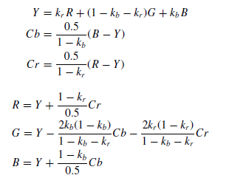
Colour Space
Jpeg is independent of any color space model such as RGB, HIS, CMY
Best compression ratio if YUV or YCrCb is use
Convert RGB to YCrCb
k_{b} = 0.114
k_{r} = 0.299

Slide 14
Convert Colour Space and level shift
void precalculate_YCbCr_tables(){
WORD R,G,B;
for (R=0;R<=255;R++){
YRtab[R]=(SDWORD)(65536*0.299+0.5)*R;
CbRtab[R]=(SDWORD)(65536*-0.16874+0.5)*R;
CrRtab[R]=(SDWORD)(32768)*R;
}
for (G=0;G<=255;G++){
YGtab[G]=(SDWORD)(65536*0.587+0.5)*G;
CbGtab[G]=(SDWORD)(65536*-0.33126+0.5)*G;
CrGtab[G]=(SDWORD)(65536*-0.41869+0.5)*G;
}
for (B=0;B<=255;B++){
YBtab[B]=(SDWORD)(65536*0.114+0.5)*B;
CbBtab[B]=(SDWORD)(32768)*B;
CrBtab[B]=(SDWORD)(65536*-0.08131+0.5)*B;
}
}
#define Y(R,G,B) ((BYTE)((YRtab[(R)]+YGtab[(G)]+YBtab[(B)])>>16)-128)
#define Cb(R,G,B) ((BYTE)((CbRtab[(R)]+CbGtab[(G)]+CbBtab[(B)])>>16))
#define Cr(R,G,B) ((BYTE)((CrRtab[(R)]+CrGtab[(G)]+CrBtab[(B)])>>16))

Slide 15
Encoding Process
Load data units in buffer from left to right, top to down.
Encode each unit data to the end of image:
  FDCT Trans form.
  Quantization.
  Zigzag Reorder.
  Encode DC & ACs.
Notes:
15

Slide 16
Load Data Units
void load_data_units_from_RGB_buffer(WORD xpos,WORD ypos){
BYTE x,y;
BYTE pos=0;
DWORD location;
BYTE R,G,B;
location=ypos*Ximage+xpos;
for (y=0;y<8;y++){
for (x=0;x<8;x++){
R=RGB_buffer[location].R;G=RGB_buffer[location].G;B=RGB_buffer[location].B;
YDU[pos]=Y(R,G,B);
CbDU[pos]=Cb(R,G,B);
CrDU[pos]=Cr(R,G,B);
location++;pos++;}
location+=Ximage-8;
}}}
Because the contents of image are stored in 1 dimensional array, we read an 8x8 block’s contents by reading contents of each 8 continuous address after each Ximage distance (from 0 index).
Notes:
16

Slide 17
2-D Discrete Cosine Transform
Forward
equal
  G = D * F * D’ where D is DCT matrix
Invert
equal
  F = D * G * D’ where D is DCT matrix

Slide 18
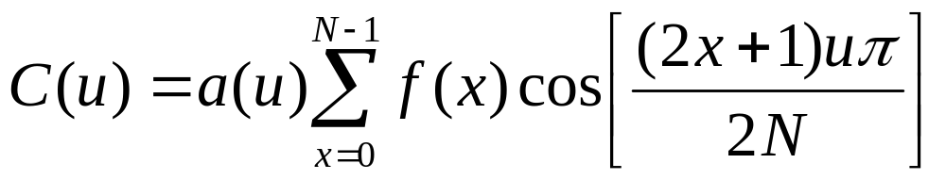
Forward Discrete Cosine Transform
Use 1d-DCT for columns and rows to implement 2d-DCT

Slide 19
DCT Transformation on rows
dataptr = datafloat;
for (ctr = 7; ctr >= 0; ctr--) {
tmp0 = dataptr[0] + dataptr[7];
tmp7 = dataptr[0] - dataptr[7];
tmp1 = dataptr[1] + dataptr[6];
tmp6 = dataptr[1] - dataptr[6];
tmp2 = dataptr[2] + dataptr[5];
tmp5 = dataptr[2] - dataptr[5];
tmp3 = dataptr[3] + dataptr[4];
tmp4 = dataptr[3] - dataptr[4];
// Even part
tmp10 = tmp0 + tmp3;// phase 2
tmp13 = tmp0 - tmp3;
tmp11 = tmp1 + tmp2;
tmp12 = tmp1 - tmp2;
dataptr[0] = tmp10 + tmp11; // phase 3
dataptr[4] = tmp10 - tmp11;
z1 = (tmp12 + tmp13) * ((float) 0.707106781); // c4
dataptr[2] = tmp13 + z1;// phase 5
dataptr[6] = tmp13 - z1;

Slide 20
DCT Transformation on rows (cont)
//odd part
tmp10 = tmp4 + tmp5;// phase 2
tmp11 = tmp5 + tmp6;
tmp12 = tmp6 + tmp7;
// The rotator is modified from fig 4-8 to avoid extra negations
z5 = (tmp10 - tmp12) * ((float) 0.382683433); // c6
z2 = ((float) 0.541196100) * tmp10 + z5; // c2-c6
z4 = ((float) 1.306562965) * tmp12 + z5; // c2+c6
z3 = tmp11 * ((float) 0.707106781); // c4
z11 = tmp7 + z3;// phase 5
z13 = tmp7 - z3;
dataptr[5] = z13 + z2;// phase 6
dataptr[3] = z13 - z2;
dataptr[1] = z11 + z4;
dataptr[7] = z11 - z4;
dataptr += 8; // pointer to next row
}
DCT Transformation on columns is similar.

Slide 21
Quantization
Reduce or decrease the precision of coefficients
T’(u,v) = round[T(u,v)/Q(u,v)]
where
  T’(u,v) is quantized DCT coefficients
  Q(u,v) is a quantize table
Q * quality (best or worst compression)

Slide 22
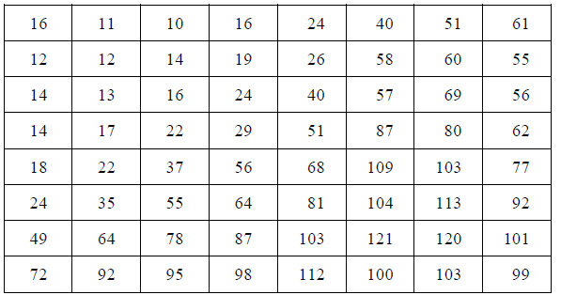
Quantization table
Luminance quantization table

Slide 23
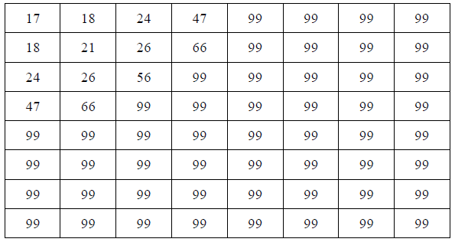
Quantization table (cont)
Chrominance quantization table

Slide 24
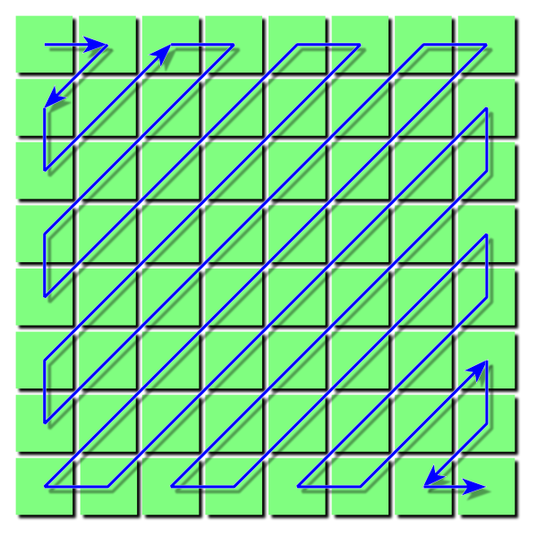
Zigzag Scanner
Use zigzag patern to reorder quantized DCT coefficients
Use huffman coding to encode coefficients patern

Slide 25
Quantization & ZigZag
To quantize the values of data unit, just simple mutiply each value with associated value in quantization table.
for (i = 0; i < 64; i++) {
// Apply the quantization and scaling factor
temp = datafloat[i] * fdtbl[i];
}
Use a zigzag array to store zigzag sequence of indexs.
static BYTE zigzag[64]=
{ 0, 1, 5, 6,14,15,27,28,
2, 4, 7,13,16,26,29,42,
3, 8,12,17,25,30,41,43,
9,11,18,24,31,40,44,53,
10,19,23,32,39,45,52,54,
20,22,33,38,46,51,55,60,
21,34,37,47,50,56,59,61,
35,36,48,49,57,58,62,63 };
Reorder original sequence of DU_DCT to zigzag order.
for (i=0;i<=63;i++) DU[zigzag[i]]=DU_DCT[i];

Slide 26
Huffman Encoding
DC coefficient at position(0,0)
AC coefficient is remainder except DC
DC coefficient is coded difference to AC coefficients
Difference code = DC_{i} – DC_{i-1} where DC_{i} is DC coefficient of i-th block

Slide 27
Huffman Encoding (cont)
AC coefficient is coded by run length coding and huffman coding
(Run length, size) (amplitude)
RUNLENGTH is the number of zeroes that came before this non-zero AC coefficient
SIZE is the number of bits required to represent
AMPLITUDE is the bit-representation.

Slide 28
Huffman Encoding (cont)
Jpeg use multiple huffman to encode DCT coefficients if image have many components.
Some default huffman table for DCT coefficient of each component is defined in ITU T81 document.

Slide 29
Huffman Encoding (cont)
void compute_Huffman_table(BYTE *nrcodes,BYTE *std_table,bitstring *HT){
BYTE k,j;
BYTE pos_in_table;
WORD codevalue;
codevalue=0; pos_in_table=0;
for (k=1;k<=16;k++){
for (j=1;j<=nrcodes[k];j++){
HT[std_table[pos_in_table]].value=codevalue;
HT[std_table[pos_in_table]].length=k;
pos_in_table++;
codevalue++;
}
codevalue*=2;
}
}
By picking up the code at appropriate index of huffman table to get huffman code of DC/ACs coefficient of a data unit

Slide 30
Huffman Encoding – DC differences
Diff=DU[0]-*DC;
*DC=DU[0];
//Encode DC
if (Diff==0) writebits(HTDC[0]); //Diff might be 0
else {
writebits(HTDC[category[Diff]]);
writebits(bitcode[Diff]);
}

Slide 31
Huffman Encoding – ACs
Processing without last ACs = 0
end0pos = first element in reverse order !=0
for (end0pos=63;(end0pos>0)&&(DU[end0pos]==0);end0pos--) ;
if (end0pos==0) {writebits(EOB);return;}

Slide 32
Huffman Encoding – ACs
i=1;
while (i<=end0pos){
startpos=i;
for (; (DU[i]==0)&&(i<=end0pos);i++) ;
nrzeroes=i-startpos;
if (nrzeroes>=16){
for (nrmarker=1;nrmarker<=nrzeroes/16;nrmarker++){ writebits(M16zeroes);}
nrzeroes=nrzeroes%16;
}
writebits(HTAC[nrzeroes*16+category[DU[i]]]);
writebits(bitcode[DU[i]]);
i++;
}
if (end0pos!=63) writebits(EOB);

Slide 33
Write Encoded Image
Write Start of Image byte (0xFFD8)
Write Header:
write_APP0info();
write_DQTinfo();
write_SOF0info();
write_DHTinfo();
write_SOSinfo();
Write Encoded Data Units ( after encode each data unit)
Write End of Image byte (0xFFD9)

Slide 34
Decode

Slide 35
Overview jpeg decode
ConvertJpegFile
DecodeJpegFileData
WriteBMP24

Slide 36
Overview jpeg decode (cont)
DecodeJpegFileData
JpegDecode
DecodeMCU
YcrCb_to_RGB_24_Block8x8

Slide 37
Overview jpeg decode (cont)
DecodeMCU
ProcessHuffmanDataUnit
DecodeSingleBlock

Slide 38
Overview jpeg decode (cont)
ConvertJpeg() function use to read jpeg image and convert it to bmp image.
DecodeJpegFileData() function use to decode jpeg image data.
WriteBMP24() function use to write decoded data to bitmap file.
Notes:
38

Slide 39
Overview jpeg decode (cont)
JpegDecode() function use to decode and convert YcrCb to RGB color.
DecodeMCU() function use to decode minimal code unit. MCU size is 8x8, 8x16, 16x16.
YCrCb_to_RGB24_Block8x8() use to convert decoded block data from YCrCb color space to RGB 24 bit color space.
Notes:
39

Slide 40
Overview jpeg decode (cont)
ProcessHuffmanDataUnit() function uses to decode from huffman codes to values.
DecodeSingleBlock() function uses to decode a single 8x8 pixel block.
Notes:
40

Slide 41
Read jpeg file
Jpeg file format:
  SOI: start of image
  SOF: start of frame
  DQT: define quantize table
  SOS: start of scan
  DHT: defind huffman table
  EOI: end of image

Slide 42
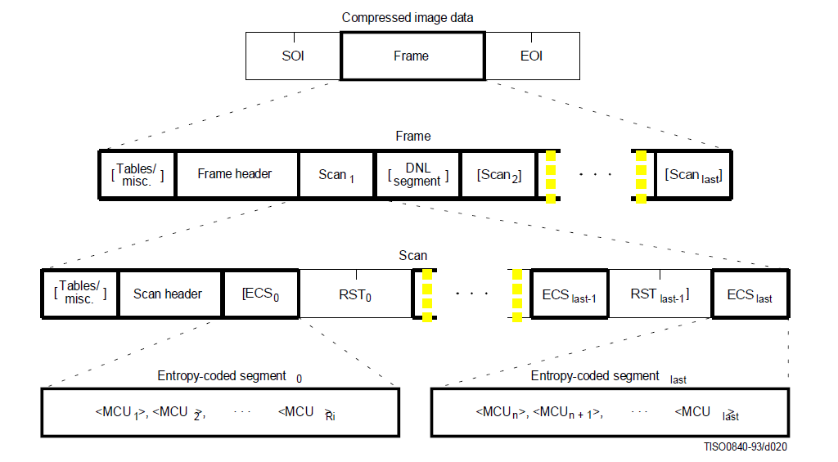
Read jpeg file (cont)

Slide 43
Read jpeg file (cont)
SOS segment contains image data which is encoded by MCUs.
Because a MCU has one or more blocks of all component, we need decode the image into MCUs to reorder blocks.

Slide 44
Decode MCU
A MCU contains one or more data unit of all components. Data unit in base line DCT is a block 8x8 pixels. The MCU size is 8x8, 8x16 or 16x16.
For non-interleave data, image data is scanned by left to right, top to bottom.
For interleave data, image data is scanned that depend on resolution of each component.

Slide 45
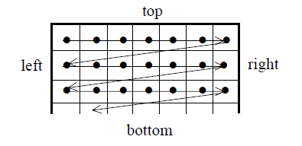
Decode MCU (cont)
Non-interleave data:
Notes:
45

Slide 46
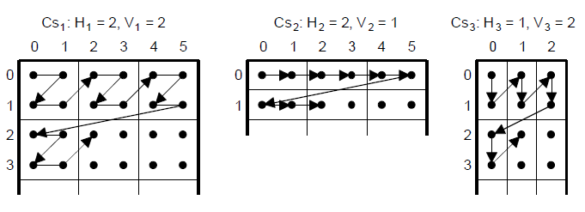
Decode MCU (cont)
Notes:
46

Slide 47
Decode MCU (cont)
In decode MCU implement, we need 2 parameter horizontal factor (h) and vertical factor (v).
If h and v equal 1, there is non-interleave data.
If h and v equal 2, there is interleave data with subsampling 4:2:0.

Slide 48
Decode MCU (cont)
inline void DecodeMCU(stJpegData *jdata, int w, int h) {
// Y
for (int y = 0; y < h; y++) {
for (int x = 0; x<w; x++) {
int stride = w * 8;
int offset = x * 8 + y * 64 * w;
ProcessHuffmanDataUnit(jdata, cY);
Notes:
48

Slide 49
Decode MCU (cont)
DBG_ASSERT(cY>0 && cY < COMPONENTS);
DBG_ASSERT(offset >= 0 && offset < 64 * 4);
DecodeSingleBlock(&jdata-> m_component_info[cY], &jdata-> m_Y[offset], stride);
}
}
// Cb
ProcessHuffmanDataUnit(jdata, cCb);
DecodeSingleBlock(&jdata-> m_component_info[cCb], jdata->m_Cb, 8);
// Cr
ProcessHuffmanDataUnit(jdata, cCr);
DecodeSingleBlock(&jdata-> m_component_info[cCr], jdata->m_Cr, 8);
}
Notes:
49

Slide 50
Decode single block
Decode a single block include the following steps:
  Huffman decode
  Dezigzag
  Dequantize
  IDCT
  Level shift
  Convert color space

Slide 51
Decode single block (cont)
inline void DecodeSingleBlock(stComponent *comp, unsigned char *outputBuf, int stride) {
short* inptr = comp->m_DCT;
float* quantptr = comp->m_qTable;
// Create a temp 8x8, i.e. 64 array for the data
int data[64] = { 0 };
// Copy our data into the temp array
for (int i = 0; i < 64; i++) {
data[i] = inptr[i];
}
Notes:
51

Slide 52
Decode single block (cont)
// De-Quantize
DequantizeBlock(data, quantptr);
// De-Zig-Zag
int block[64] = { 0 };
DeZigZag(block, data);
// Create an 8x8 array
int arrayBlock[8][8] = { 0 };
TransformArray(arrayBlock, block);
// Inverse DCT
int val[8][8] = { 0 };
PerformIDCT(val, arrayBlock);
Notes:
52

Slide 53
Huffman decode
Each image component (Y, Cr, Cb) has DC and AC coefficient.
DC coefficient is decoded by predictive coding method.
AC coefficient is decode by run length huffman coding.

Slide 54
Huffman decode (cont)
ProcessHuffmanDataUnit function is used to decode DC and AC coefficients of each component.
DC_{i} is decoded by adding with difference code of previous block.
AC_{i} is decode by using huffman code table which is enclosed in jpeg file.

Slide 55
Huffman DC decode
void ProcessHuffmanDataUnit(stJpegData *jdata, int indx) {
stComponent *c = &jdata-> m_component_info[indx];
short DCT_tcoeff[64];
memset(DCT_tcoeff, 0, sizeof(DCT_tcoeff));
bool found = false;
int decodedValue = 0;
for (int k = 1; k < 16; k++) {
int code = LookNBits(&jdata->m_stream, k);

Slide 56
Huffman DC decode (cont)
if (IsInHuffmanCodes(code, k, c->m_dcTable->m_numBlocks, c->m_dcTable->m_blocks, &decodedValue)) {
SkipNBits(&jdata->m_stream, k);
found = true;
int numDataBits = decodedValue;
if (numDataBits == 0) {
DCT_tcoeff[0] = c->m_previousDC;
}

Slide 57
Huffman DC decode (cont)
else {
if (jdata->m_restart_interval > 0)
if (jdata->m_stream[0] == 0xff && jdata->m_stream[1] != 0x00) {
jdata->m_stream += 2;
g_reservoir = 0;
g_nbits_in_reservoir = 0;
}
short data = GetNBits(&jdata->m_stream, numDataBits);
data = DetermineSign(data, numDataBits);
DCT_tcoeff[0] = data + c->m_previousDC;
c->m_previousDC = DCT_tcoeff[0];
}

Slide 58
Huffman AC decode
int nr = 1;
bool EOB_found = false;
while ((nr <= 63) && (!EOB_found)) {
int k = 0;
for (k = 1; k <= 16; k++) {
int code = LookNBits(&jdata->m_stream, k);
// Check if its one of our huffman codes
if (IsInHuffmanCodes(code, k, c->m_acTable->m_numBlocks, c->m_acTable->m_blocks, &decodedValue)) {
// Skip over k bits, since we found the huffman value
SkipNBits(&jdata->m_stream, k);

Slide 59
Huffman AC decode (cont)
// Our decoded value is broken down into 2 parts, repeating RLE, and then
// the number of bits that make up the actual value next
int valCode = decodedValue;
unsigned char size_val = valCode & 0xF;// Number of bits for our data
unsigned char count_0 = valCode >> 4;// Number RunLengthZeros
if (size_val == 0) {// RLE
if (count_0 == 0)EOB_found = true;// EOB found, go out
else if (count_0 == 0xF)
nr += 16; // skip 16 zeros
}

Slide 60
Huffman AC decode (cont)
else {
nr += count_0; //skip count_0 zeroes
if (nr > 63) {
dprintf("-|- ##ERROR## Huffman Decoding\n");
DBG_HALT;
}
short data = GetNBits(&jdata->m_stream, size_val);
data = DetermineSign(data, size_val);
DCT_tcoeff[nr++] = data;
}
break;
}
}
if (k > 16) {
nr++;
}
}

Slide 61
Dezigzag and Dequantize
Dezigzag is used to reorder DCT cooefficient.
Dequantize is performed by multiply input block and dequantize matrix.

Slide 62
Dezigzag and Dequantize (cont)
void DeZigZag(int outBlock[64], const int inBlock[64]) {
  for (int i = 0; i < 64; i++) {
  outBlock[i] = inBlock[ZigZagArray[i]];
  }
}
void DequantizeBlock(int block[64], const float quantBlock[64]) {
for (int c = 0; c < 64; c++) {
block[c] = (int)(block[c] * quantBlock[c]);
}
}

Slide 63
IDCT
void PerformIDCT(int outBlock[8][8], const int inBlock[8][8]) {
for (int y = 0; y < 8; y++) {
for (int x = 0; x < 8; x++) {
outBlock[x][y] = func(x, y, inBlock);
}
}
}

Slide 64
IDCT (cont)
int func(int x, int y, const int block[8][8]) {
const float PI = 3.14f;
float sum = 0;
for (int u = 0; u < 8; u++) {
for (int v = 0; v < 8; v++) {
sum += (C(u) * C(v)) * block[u][v] * cosf(((2 * x + 1) * u * PI) / 16) * cosf(((2 * y + 1) * v * PI) / 16);
}
}
return (int)((1.0 / 4.0) * sum);
}

Slide 65
Level shift
Level shift the DCT coefficient by adding 128.
If new value is not in range (0-255), it will be changed into 0 or 255.

Slide 66
Level shift (cont)
unsigned char *outptr = outputBuf;
for (int y = 0; y < 8; y++){
for (int x = 0; x < 8; x++) {
val[x][y] += 128;
outptr[x] = Clamp(val[x][y]);
}
outptr += stride;
}

Slide 67
Convert color space
inline void YCrCB_to_RGB24_Block8x8(stJpegData *jdata, int w, int h, int imgx, int imgy, int imgw, int imgh){
  for (int y = 0; y < (8 * h - olh); y++) {
    for (int x = 0; x < (8 * w - olw); x++) {
      if (x + imgx >= imgw) continue;
      if (y + imgy >= imgh) continue;
      int poff = x * 3 + jdata->m_width * 3 * y;
      pix = &(jdata->m_colourspace[poff]);
      int yoff = x + y*(w * 8);
      int coff = (int)(x*(1.0f / w)) + (int)(y*(1.0f / h)) * 8;

Slide 68
Convert color space (cont)
      int yc = Y[yoff];
      int cb = Cb[coff];
      int cr = Cr[coff];
      ConvertYCrCbtoRGB(yc, cr, cb, &r, &g, &b);
      pix[0] = Clamp(r);
      pix[1] = Clamp(g);
      pix[2] = Clamp(b);
    }
  }
}

Slide 69
Convert color space (cont)
inline void ConvertYCrCbtoRGB(int y, int cb, int cr,
int* r, int* g, int* b) {
  float red, green, blue;
  red = y + 1.402f*(cb - 128);
  green = y - 0.34414f*(cr - 128) - 0.71414f*(cb - 128);
  blue = y + 1.772f*(cr - 128);
  *r = (int)Clamp((int)red);
  *g = (int)Clamp((int)green);
  *b = (int)Clamp((int)blue);
}

Slide 70
Write bitmap file
Write decoded image to file with bitmap format.
Bitmap file format includes:
  Bitmap header
  Color table
  Image data
Bitmap image is written from RGB buffer by reverse order. The last row is first written to file.
If image size is not divided by 8, it is padded by zero at the last of each row.

Slide 71
Write bitmap file (cont)
for (int y = Height - 1; y >= 0; y--) {
for (int x = 0; x<Width; x++) {
int i = (x + (Width)*y) * 3;
unsigned int rgbpix = (RGB[i] << 16) | (RGB[i + 1] << 8) | (RGB[i + 2] << 0);
fwrite(&rgbpix, 3, 1, fp);
}
if (iNumPaddedBytes>0) {
unsigned char pad = 0;
fwrite(&pad, iNumPaddedBytes, 1, fp);
}
}

Slide 72
References
"Digital Compression and Coding of Continuous-Tone Still Images, Requirements and Guidelines," Document number ITU-T T.81 or ISO/IEC 10918-1.
Wallace, Gregory K., "The JPEG Still Picture Compression Standard," Communications of the ACM, vol. 34, no. 4, April 1991, pp. 30-44.

Slide 73
References
http://en.wikipedia.org/wiki/BMP_file_format
http://www.ue.eti.pg.gda.pl/fpgalab/zadania.spartan3/zad_vga_struktura_pliku_bmp_en.html

