Slide 1
Feature Detection
Instructor
LE Thanh Sach, Ph.D.
Ltsach@cse.hcmut.edu.vn
http://www.cse.hcmut.edu.vn/~ltsach/

Slide 2
Outline
Image features
Corner feature:
  Moravec
  Harris
Scale Invariant Feature Transform (SIFT)
Speed Up Robust Features (SURF)
Gradient Location Orientation Histogram (GLOH)
Multi-Scale Oriented Patches (MSOP)
Feature Matching

Slide 3
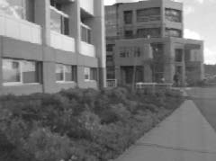
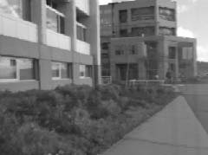
Feature: Concept
?
Feature can be defined as the information which is extracted (detect + describe) from images and is aimed to be used for further tasks in computer vision, for examples, classification, matching, and tracking.
Notes:
3

Slide 4
Feature: Assessment Criteria
Distinctive: a single feature can be correctly matched with high probability.
Invariant: invariant to scale, rotation, affine, illumination and noise for robust matching across a substantial range of affine distortion, viewpoint change and so on.
Notes:
4

Slide 5
Feature: Tasks
Feature detection locates where they are
Feature description describes what they are
Feature matching decides whether two are the same one
Notes:
5

Slide 6
Corner detector
Notes:
6

Slide 7
Moravec corner detector (1980)
Corner point:
  Be easily recognized by looking through a small window
  Shift a window in any direction should give a large change in intensity
Notes:
7

Slide 8
Moravec corner detector
flat
Notes:
8

Slide 9
Moravec corner detector
flat
Notes:
9

Slide 10
Moravec corner detector
flat
edge
Notes:
10

Slide 11
Moravec corner detector
corner
isolated point
flat
edge
Notes:
11

Slide 12
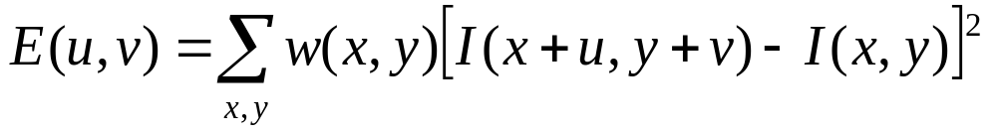
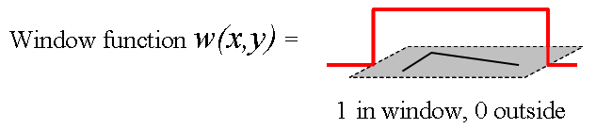
Moravec corner detector
Change of intensity for the shift [u,v]:
window function
shifted intensity
intensity
Notes:
12

Slide 13
Moravec corner detector
Change of intensity for the shift [u,v]:
window function
shifted intensity
intensity
Four shifts: (u,v) = (1,0), (1,1), (0,1), (-1, 1)
➔Look for local maxima in ≡ min{E(u,v)}
Notes:
13

Slide 14
Problems of Moravec detector
(Problem 1): Noisy response
  due to a binary window function
(Problem 2): Only a set of shifts at every 45 degree is considered
(Problem 3): Only minimum of E is taken into account
Harris corner detector (1988) solves these problems.
Notes:
14

Slide 15
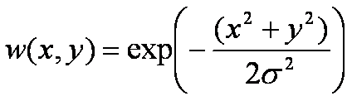
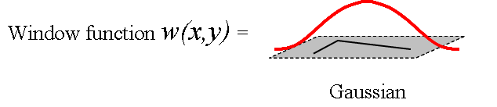
Harris corner detector
(Problem 1): Noisy response due to a binary window function
➔Use a Gaussian function
Notes:
15

Slide 16
Harris corner detector
(Problem 2): Only a set of shifts at every 45 degree is considered
➔ Consider all small shifts by Taylor’s expansion
Notes:
16

Slide 17


Harris corner detector
Taylor expansion:
(1st order)
(2nd order)
(3rd order)
(higher order)
Notes:
17

Slide 18

Harris corner detector
1st order approximation:
Notes:
18

Slide 19



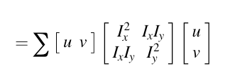

Harris corner detector
(1st approximation)
(matrix form)
Notes:
19

Slide 20
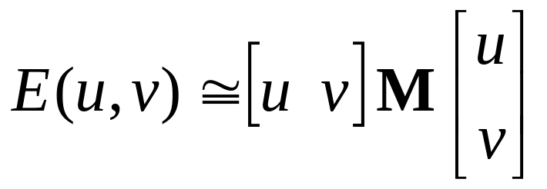
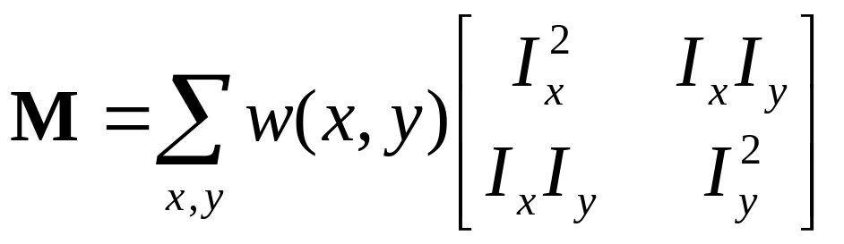
Harris corner detector
Equivalently, for small shifts [u,v] we have a bilinear approximation:
Where M is a 2×2 matrix computed from image derivatives:
Notes:
20

Slide 21
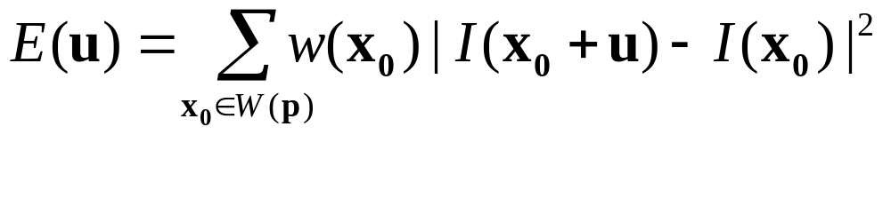
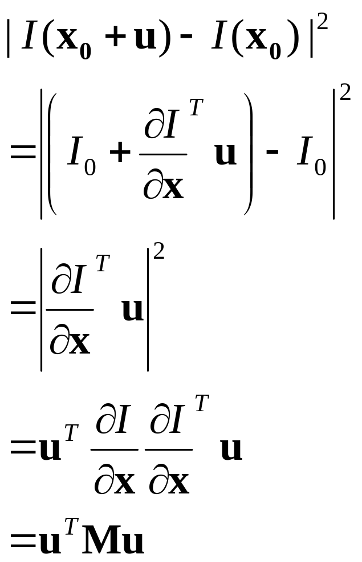
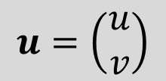
Harris corner detector (matrix form)
$$u=\left(\begin{matrix}u \\ v\end{matrix}\right)$$
Notes:
21

Slide 22
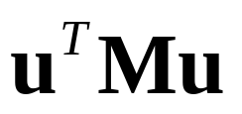
Harris corner detector
Only minimum of E is taken into account
A new corner measurement by investigating the shape of the error function
represents a quadratic function; Thus, we can analyze E’s shape by looking at the property of M
Notes:
22

Slide 23
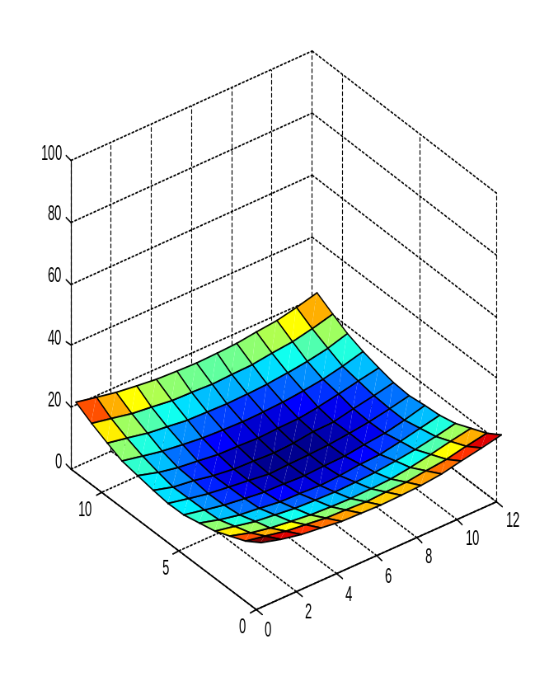
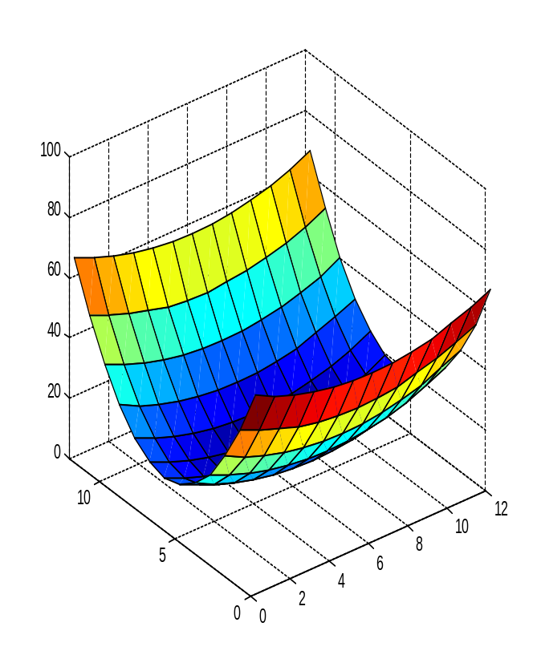
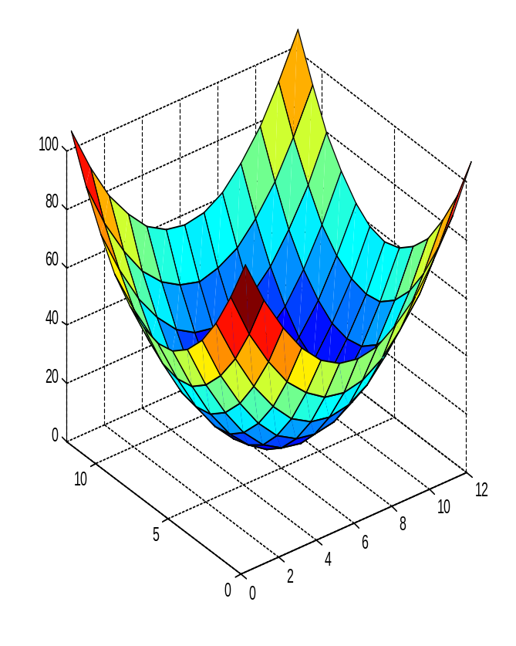
Harris corner detector
flat
edge
corner
High-level idea: what shape of the error function will we prefer for features?

Slide 24
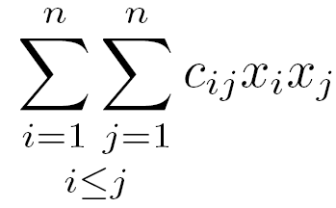
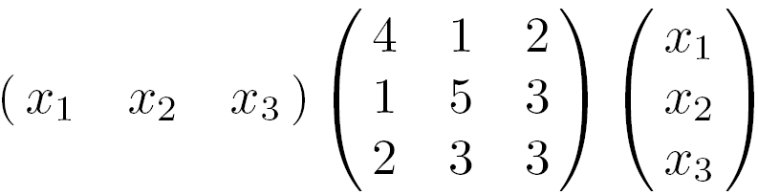
Quadratic forms
=
Quadratic form (homogeneous polynomial of degree two) of n variables x_{i}
Examples
Notes:
24
See W W L Chen’s linear algebra book, chap 11

Slide 25
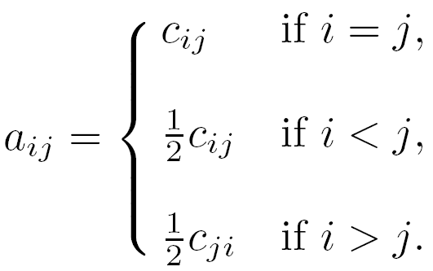
Symmetric matrices
Quadratic forms can be represented by a real symmetric matrix A where
Notes:
25

Slide 26
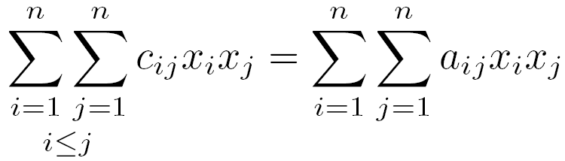
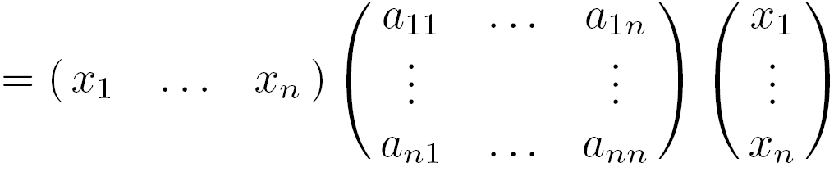


Symmetric matrices
Quadratic forms can be represented by a real symmetric matrix A where
Notes:
26

Slide 27
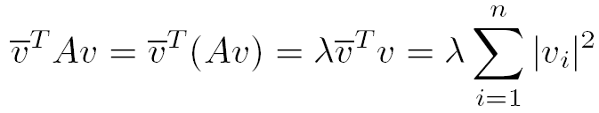
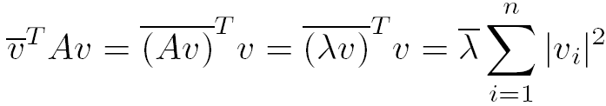


Eigenvalues of symmetric matrices
Brad Osgood
Notes:
27

Slide 28

Eigenvectors of symmetric matrices
Notes:
28

Slide 29
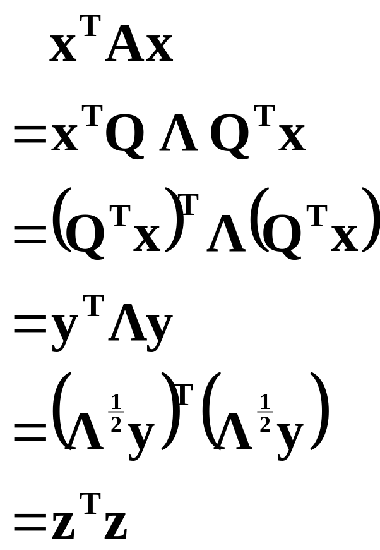
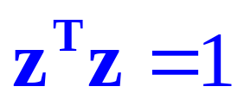
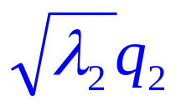
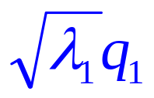
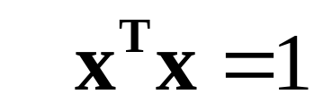
Eigenvectors of symmetric matrices
Notes:
29
藍色座標系內的正圓在黑色座標系內看起來變成橢圓。

Slide 30
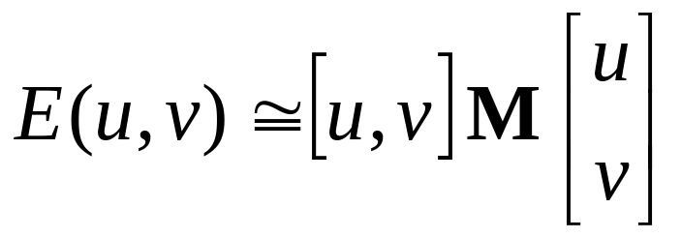
Harris corner detector
Intensity change in shifting window: eigenvalue analysis
λ₁, λ₂ – eigenvalues of M
Ellipse E(u,v) = const
direction of the fastest change
direction of the slowest change
(λ_{max})^{-1/2}
(λ_{min})^{-1/2}
Notes:
30

Slide 31
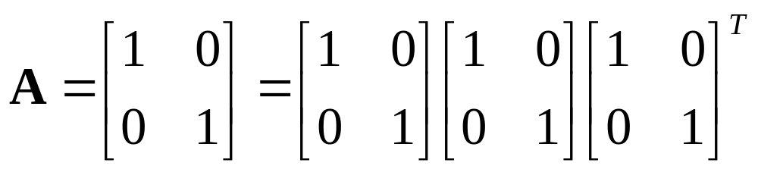
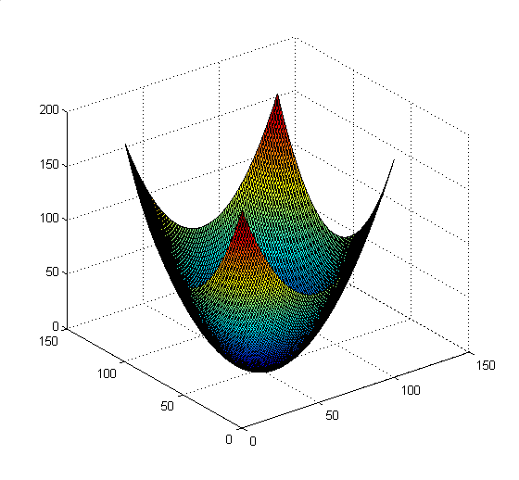
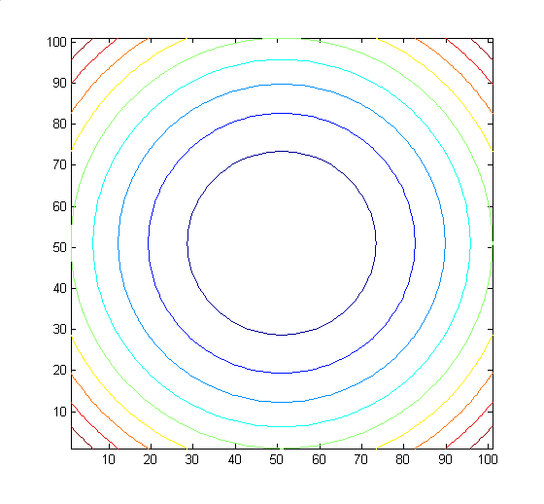
Visualize quadratic functions
Notes:
31

Slide 32
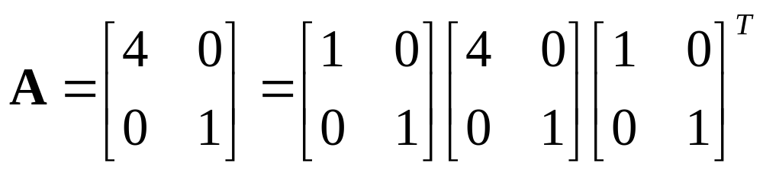
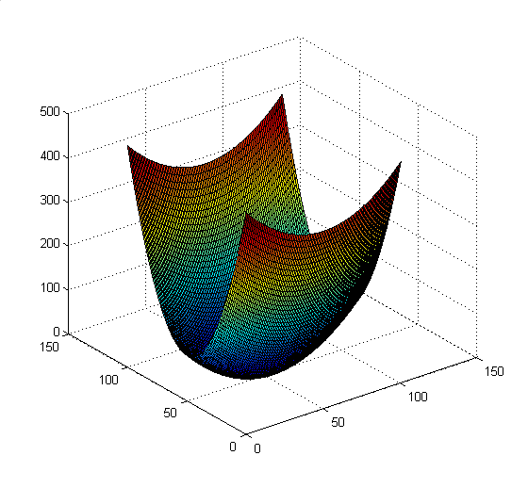
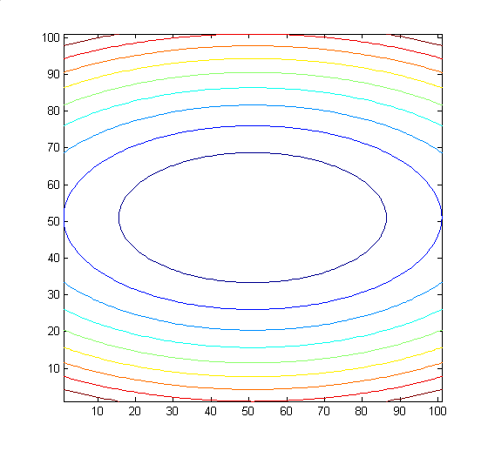
Visualize quadratic functions
Notes:
32

Slide 33
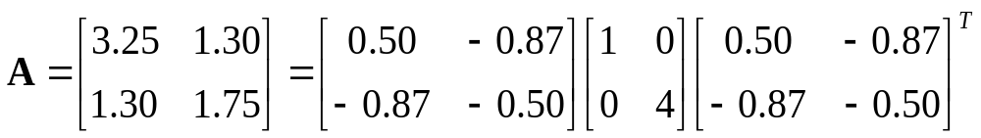
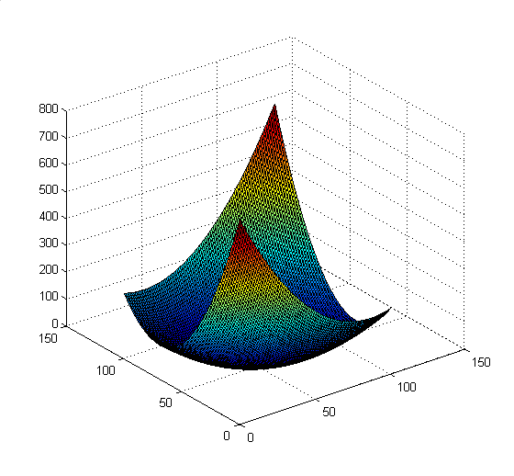
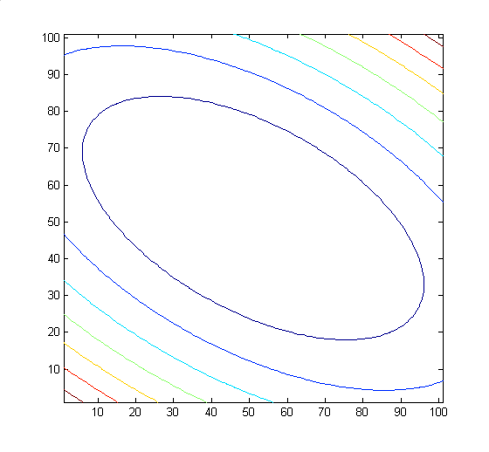
Visualize quadratic functions
Notes:
33

Slide 34
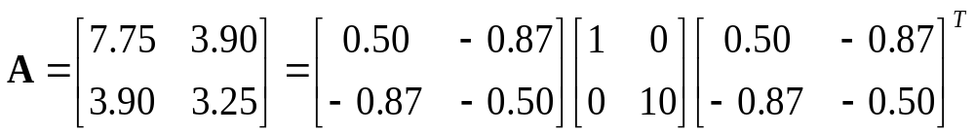
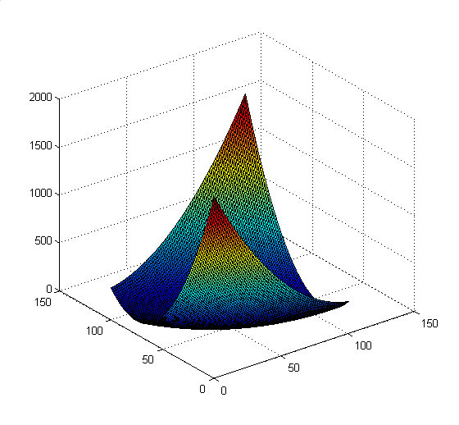
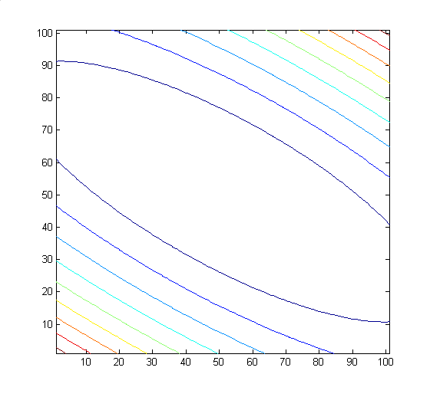
Visualize quadratic functions
Notes:
34

Slide 35
Harris corner detector
Classification of image points using eigenvalues of M:
λ₂
edge
λ₂ >> λ₁
Corner
λ₁ and λ₂ are large,
λ₁ ~ λ₂;
E increases in all directions
λ₁ and λ₂ are small;
E is almost constant in all directions
edge
λ₁ >> λ₂
flat
λ₁
Notes:
35

Slide 36
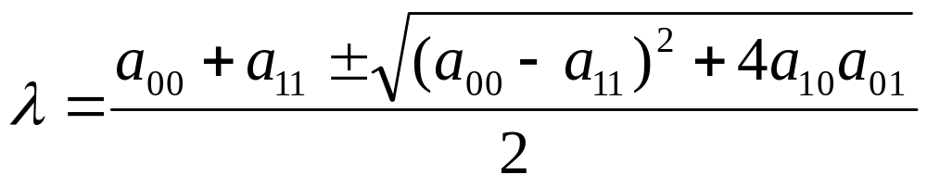
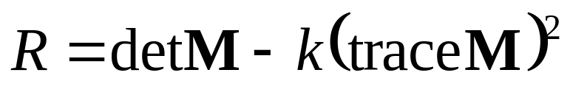
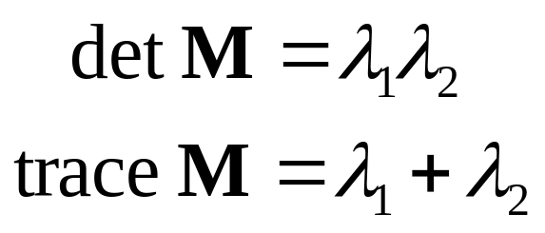
Harris corner detector
Only for reference,
you do not need
them to compute R
Measure of corner response:
(k – empirical constant, k = 0.04-0.06)
Notes:
36
http://mathworld.wolfram.com/Eigenvalue.html

Slide 37
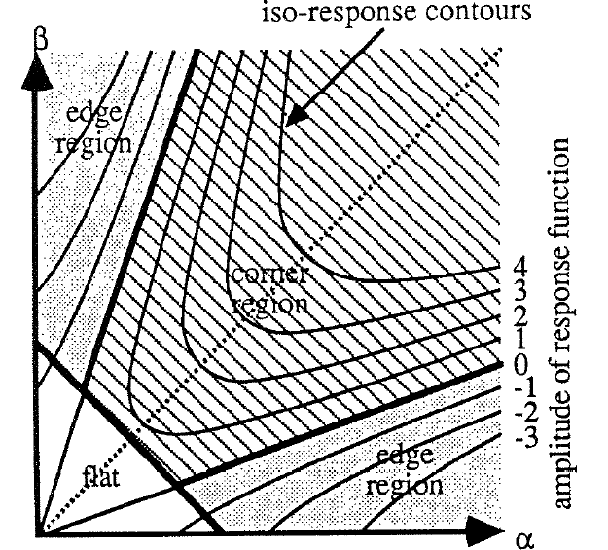
Harris corner detector
Notes:
37

Slide 38
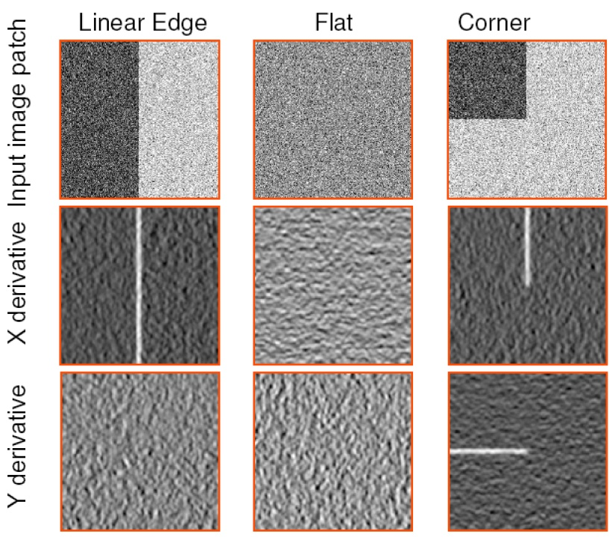
Another view
Notes:
38

Slide 39
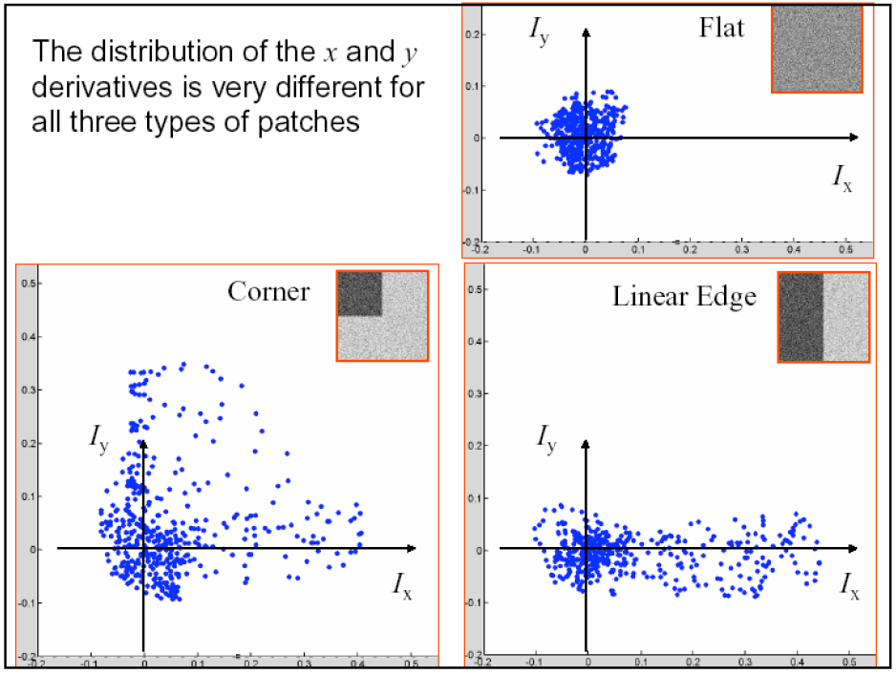
Another view
Notes:
39

Slide 40
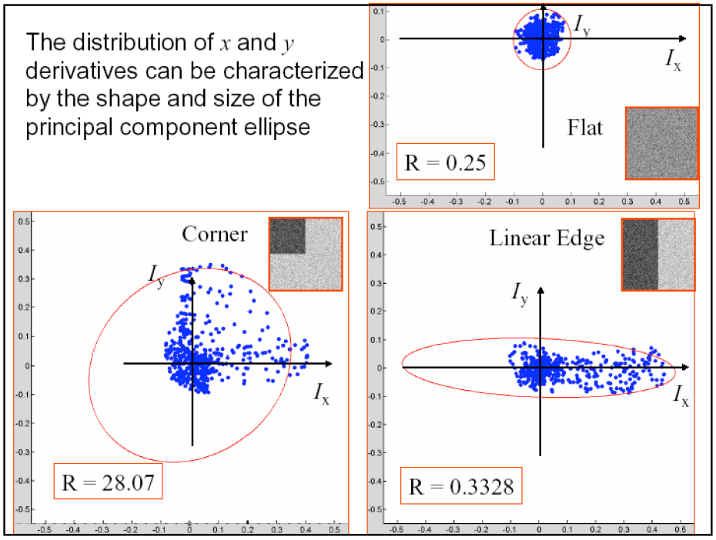
Another view
Notes:
40

Slide 41
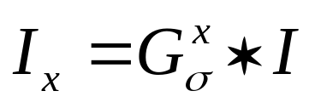
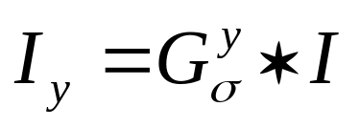






Summary of Harris detector
Compute x and y derivatives of image
Compute products of derivatives at every pixel
Compute the sums of the products of derivatives at each pixel

Slide 42


Summary of Harris detector
Define the matrix at each pixel
Compute the response of the detector at each pixel
Threshold on value of R; compute nonmax suppression.

Slide 43

Harris corner detector (input)
Notes:
43

Slide 44

Corner response R
Notes:
44

Slide 45

Threshold on R
Notes:
45

Slide 46

Local maximum of R
Notes:
46

Slide 47

Harris corner detector
Notes:
47

Slide 48

Harris detector: summary
Average intensity change in direction [u,v] can be expressed as a bilinear form:
Describe a point in terms of eigenvalues of M:
measure of corner response
A good (corner) point should have a large intensity change in all directions, i.e. R should be large positive
Notes:
48

Slide 49
Now we know where features are
But, how to match them?
What is the descriptor for a feature? The simplest solution is the intensities of its spatial neighbors. This might not be robust to brightness change or small shift/rotation.
1
2
3
4
5
6
7
8
9
(
)
1
2
3
4
5
6
7
8
9
Notes:
49

Slide 50
Harris detector: some properties
Partial invariance to affine intensity change
Only derivatives are used => invariance to intensity shift I → I + b
Intensity scale: I → a I
R
R
threshold
x (image coordinate)
x (image coordinate)
Notes:
50

Slide 51
Harris Detector: Some Properties
Rotation invariance
Ellipse rotates but its shape (i.e. eigenvalues) remains the same
Corner response R is invariant to image rotation
Notes:
51

Slide 52



Harris Detector is rotation invariant
Repeatability rate:
# correspondences
# possible correspondences
Notes:
52

Slide 53
Harris Detector: Some Properties
But: not invariant to image scale!
All points will be classified as edges
Corner !
Notes:
53

Slide 54


Harris detector: some properties
Quality of Harris detector for different scale changes
Repeatability rate:
# correspondences
# possible correspondences
Notes:
54

Slide 55
Scale invariant detection
Consider regions (e.g. circles) of different sizes around a point
Regions of corresponding sizes will look the same in both images
Notes:
55

Slide 56
Scale invariant detection
The problem: how do we choose corresponding circles independently in each image?
Aperture problem
Notes:
56

Slide 57
SIFT
(Scale Invariant Feature Transform)
Notes:
57

Slide 58
SIFT
SIFT is an carefully designed procedure with empirically determined parameters for the invariant and distinctive features.
Notes:
58

Slide 59

SIFT stages:
Scale-space extrema detection
Keypoint localization
Orientation assignment
Keypoint descriptor
detector
descriptor
( )
local descriptor
A 500x500 image gives about 2000 features
Notes:
59

Slide 60
1. Detection of scale-space extrema
For scale invariance, search for stable features across all possible scales using a continuous function of scale, scale space.
SIFT uses DoG filter for scale space because it is efficient and as stable as scale-normalized Laplacian of Gaussian.
Notes:
60

Slide 61




1. Detection of scale-space extrema
DoG filtering
Convolution with a variable-scale Gaussian
Difference-of-Gaussian (DoG) filter
Convolution with the DoG filter
Notes:
61

Slide 62

1. Detection of scale-space extrema
Scale space
2k²σ
2kσ
2kσ
2σ
2σ
kσ
kσ
σ
σ
Notes:
62

Slide 63
1. Detection of scale-space extrema
Scale space
D(x,y, σ₃)
D(x,y, σ₂)
D(x,y, σ₁)
D(x,y, σ₀)
Notes:
63

Slide 64


1. Detection of scale-space extrema
Examples
Notes:
64

Slide 65

1. Detection of scale-space extrema
Key-points localization
Point: X
Coordinate: D(x,y,σ)
X is selected as a key-point,
if it is larger or smaller than all 26 neighbors
Notes:
65

Slide 66
1. Detection of scale-space extrema
Decide scale sampling frequency
It is impossible to sample the whole space, tradeoff efficiency with completeness.
Decide the best sampling frequency by experimenting on 32 real image subject to synthetic transformations. (rotation, scaling, affine stretch, brightness and contrast change, adding noise…)
Notes:
66

Slide 67

1. Detection of scale-space extrema
Decide scale sampling frequency
Notes:
67

Slide 68

1. Detection of scale-space extrema
Decide scale sampling frequency
for detector,
repeatability
for descriptor,
distinctiveness
s=3 is the best, for larger s, too many unstable features
Notes:
68

Slide 69

1. Detection of scale-space extrema
Pre-smoothing
σ =1.6, plus a double expansion
Notes:
69

Slide 70

1. Detection of scale-space extrema
Scale Invariance
Notes:
70

Slide 71
2. Accurate key-point localization
Fit a 3D quadratic function for finding sub-pixel maxima
Reject key-points with low contrast areas
Reject key-points on edges
Notes:
71

Slide 72
2. Accurate keypoint localization:
Fit a 3D quadratic function
6
5
Find them
1
-1
0
+1
Idea:
Notes:
72

Slide 73

2. Accurate keypoint localization:
Fit a 3D quadratic function
6
5
1
-1
0
+1
Idea:
Notes:
73

Slide 74




2. Accurate keypoint localization:
Fit a 3D quadratic function
If Minimum/Maximum is at $\hat{x}$ then
$\hat{x}$ is the solution of the following equation:
$${\hat{f}}^{′}\left(x\right)=0$$
Minimum/Maximum is:
$$\hat{f}\left(\hat{x}\right)$$
Idea:
  Use Taylor Expansion:
Notes:
74

Slide 75






2. Accurate key-point localization:
Fit a 3D quadratic function
6
5
1
-1
0
+1
Notes:
75

Slide 76


2. Accurate key-point localization:
Fit a 3D quadratic function
Where,
Notes:
76

Slide 77



2. Accurate key-point localization:
Fit a 3D quadratic function
Scalar
Vector: 1×3
Matrix: 3×3
Notes:
77

Slide 78


2. Accurate key-point localization:
Fit a 3D quadratic function
How to compute derivatives, for example, 2D function f(x,y):
f(x,y)
Derivatives:
Notes:
78

Slide 79

2. Accurate key-point localization:
Fit a 3D quadratic function
Derivatives:
Notes:
79

Slide 80

2. Accurate key-point localization:
Fit a 3D quadratic function
Derivatives:
Notes:
80

Slide 81

2. Accurate key-point localization:
Fit a 3D quadratic function
Derivatives:
Notes:
81

Slide 82

2. Accurate key-point localization:
Fit a 3D quadratic function
Finding maximum/minimum by solving the following equation:
Notes:
82

Slide 83



2. Accurate key-point localization:
Fit a 3D quadratic function
Question:
How to compute derivative of the following forms?
Notes:
83

Slide 84


2. Accurate key-point localization:
Fit a 3D quadratic function
Notes:
84

Slide 85

2. Accurate key-point localization:
Fit a 3D quadratic function
Notes:
85

Slide 86

2. Accurate key-point localization:
Fit a 3D quadratic function
Notes:
86

Slide 87


2. Accurate key-point localization:
Fit a 3D quadratic function
Differentiate two sides
(A is symmetric)
Notes:
87

Slide 88


2. Accurate key-point localization:
Fit a 3D quadratic function
Maximum/Minimum is the solution of:
Notes:
88

Slide 89


2. Accurate key-point localization:
Fit a 3D quadratic function
Maximum/Minimum at:
Maximum/Minimum is:
Notes:
89

Slide 90

2. Accurate key-point localization:
Reject key-points at low contrast areas
If any dimension of $\hat{X}$ is larger than 0.5: change sample point
If $\hat{D}\left(\hat{X}\right)<0.03$: Throw out the minimum/maximum
Notes:
90

Slide 91




2. Accurate key-point localization:
Reject key-points on edges
Hessian matrix at keypoint location
Let
Keep the points with
r=10
Notes:
91

Slide 92

2. Accurate key-point localization:
Examples
Notes:
92

Slide 93

2. Accurate key-point localization:
After removing points at low contrast areas or on edges
Notes:
93

Slide 94




2. Accurate key-point localization:
Other examples
233x89
832 extrema
729 after con-
trast filtering
536 after cur-
vature filtering
Notes:
94

Slide 95
3. Orientation assignment
By assigning a consistent orientation, the keypoint descriptor can be orientation invariant.
For a keypoint, L is the Gaussian-smoothed image with the closest scale,
Notes:
95

Slide 96

3. Orientation assignment
Compute orientation
(Lx, Ly)
m
θ
orientation histogram (36 bins)
Notes:
96

Slide 97

3. Orientation assignment
Examples
Notes:
97

Slide 98

3. Orientation assignment
Demonstration
Notes:
98

Slide 99

3. Orientation assignment
Demonstration
Notes:
99

Slide 100

3. Orientation assignment
Determine the most important orientation
a. Weighting the gradient’s magnitude of key-points, using Gaussian function.
σ = 1.5*scale of the key-point
Notes:
100

Slide 101

3. Orientation assignment
Determine the most important orientation
b. Computing the histogram of the gradient’s magnitude of key-points.
Notes:
101

Slide 102

3. Orientation assignment
Determine the most important orientation
c. Finding the histogram’s peaks. Using fitting to obtain accurate the peaks’ position
Notes:
102

Slide 103

3. Orientation assignment
Determine the most important orientation
Notes:
103

Slide 104

3. Orientation assignment
Determine the most important orientation
Summarization
36-bin orientation histogram over 360°, weighted by m and 1.5*scale falloff
Peak is the orientation
Local peak within 80% creates multiple orientations
About 15% has multiple orientations and they contribute a lot to stability
Notes:
104

Slide 105

3. Orientation assignment
The most important orientation: Demo
Notes:
105

Slide 106

4. Local image descriptor
Most important orientation
A Key-point
Gradient sub-image
Size: 16×16 cells
Cell: pixel or resampled cell
Gaussian function for weighting magnitudes
σ = 0.5 window’ size
Notes:
106

Slide 107
4. Local image descriptor
a. Divide key-point’s window into 4×4 cells
b. Create 8-bin histogram for gradients inside each cell
A feature vector has 4×4×8 = 128 components
Notes:
107

Slide 108

4. Local image descriptor
Why 4x4x8?
Notes:
108

Slide 109

4. Local image descriptor
Sensitivity to affine change
Notes:
109

Slide 110
Feature matching
for a feature x, he found the closest feature x₁
and the second closest feature x₂. If the distance ratio of d(x, x₂) and d(x, x₁) is smaller than 0.8, then it is accepted as a match.
Notes:
110

Slide 111
SIFT: Summary
Create scale-space
Notes:
111

Slide 112
SIFT: Summary
Determine extrema
Notes:
112

Slide 113

SIFT: Summary
Remove low contrast points
Notes:
113

Slide 114
SIFT: Summary (Vfeat)
Remove edge points
Notes:
114

Slide 115
SIFT: Summary
Generate descriptor
Notes:
115

Slide 116
SURF
Speeded Up Robust Features

Slide 117

SURF: Speeded Up Robust Features
Speed-up computations by fast approximation of (i) Hessian matrix and (ii) descriptor using “integral images”.
What is an “integral image”?
Herbert Bay, Tinne Tuytelaars, and Luc Van Gool, “SURF: Speeded Up Robust Features”, European Computer Vision Conference (ECCV), 2006.
Notes:
117
117

Slide 118



Integral Image
The integral image I_{Σ}(x,y) of an image I(x, y) represents the sum of all pixels in I(x,y) of a rectangular region formed by (0,0) and (x,y).
.
Using integral images, it takes only four array references to calculate the sum of pixels over a rectangular region of any size.
Notes:
118
118

Slide 119
SURF: Speeded Up Robust Features (cont’d)
Approximate L_{xx}, L_{yy}, and L_{xy} using box filters
Those values can be computed very fast using integral images!
Notes:
119
119

Slide 120


SURF: Speeded Up Robust Features (cont’d)
(box filters shown are 9 x 9
– good approximations for a Gaussian with σ=1.2)
derivative
approximation
derivative
approximation
Notes:
120
120

Slide 121

SURF
In SIFT
  Original images are repeatedly smoothed with a Gaussian
  Then, sub-sampled to achieve a higher level of the pyramid.
Notes:
121
121

Slide 122

SURF
In SURF:
  use filters of larger size on the original image.
  SPEED-UP: use integral images to compute the filter’s response
Notes:
122
122

Slide 123

SURF vs. SIFT
Approximation of H:
Using DoG
Using box filters
Notes:
123
123

Slide 124


SURF
Instead of using a different measure for selecting the location and scale of interest points (e.g., Hessian and DOG in SIFT), SURF uses the determinant of to find both.
Determinant elements must be weighted to obtain a good approximation:
Notes:
124
124

Slide 125
SURF
Once interest points have been localized both in space and scale, the next steps are:
  (1) Orientation assignment
  (2) Keypoint descriptor
Notes:
125
125

Slide 126


SURF
Orientation assignment
Circular neighborhood of
radius 6σ around the interest point
(σ = the scale at which the point was detected)
60⁰
^{window}
x response y response
dx
Haar wavelets (responses weighted with Gaussian)
side length = 4σ
dy
Can be computed very fast using integral images!
Notes:
126
126

Slide 127
SURF
Orientation assignment
  - The image is convoluted with two first-order Haar wavelets.
  - The filter responses at certain sampling points around the keypoint are represented as a vector in a two-dimensional space.
  - A rotating window of 60⁰ is used to sum up all vectors within its range, and the longest resulting vector determines the orientation.

Slide 128

SURF
Keypoint descriptor (square region of size 20σ)
4 x 4
grid
Sum the response over each sub-region for dx and dy separately.
To bring in information about the polarity of the intensity changes, extract the sum of absolute value of the responses too.
Feature vector size:
4 x 16 = 64
Notes:
128
128

Slide 129
SURF
SURF-128
  The sum of d_{x} and |d_{x}| are computed separately for points where d_{y} < 0 and d_{y} >0
  Similarly for the sum of d_{y} and |d_{y}|
  More discriminatory!
Notes:
129
129

Slide 130
SURF: Speeded Up Robust Features
Has been reported to be 3 times faster than SIFT.
Less robust to illumination and viewpoint changes compared to SIFT.
K. Mikolajczyk and C. Schmid,"A Performance Evaluation of Local Descriptors",
IEEE Transactions on Pattern Analysis and Machine Intelligence, vol. 27, no. 10,
pp. 1615-1630, 2005.
Notes:
130
130

Slide 131
SIFT extensions
Notes:
131

Slide 132

PCA
Notes:
132

Slide 133
PCA-SIFT
Only change step 4
Pre-compute an eigen-space for local gradient patches of size 41x41
2x39x39=3042 elements
Only keep 20 components
A more compact descriptor
Notes:
133

Slide 134


GLOH (Gradient location-orientation histogram)
SIFT
17 location bins
16 orientation bins
Analyze the 17x16=272-d
eigen-space, keep 128 components
SIFT is still considered the best.
Notes:
134

Slide 135
Multi-Scale Oriented Patches
Simpler than SIFT. Designed for image matching. [Brown, Szeliski, Winder, CVPR’2005]
Feature detector
  Multi-scale Harris corners
  Orientation from blurred gradient
  Geometrically invariant to rotation
Feature descriptor
  Bias/gain normalized sampling of local patch (8x8)
  Photometrically invariant to affine changes in intensity
Notes:
135

Slide 136





Multi-Scale Harris corner detector
Image stitching is mostly concerned with matching images that have the same scale, so sub-octave pyramid might not be necessary.
Notes:
136

Slide 137




Multi-Scale Harris corner detector
smoother version of gradients
Corner detection function:
Pick local maxima of 3x3 and larger than 10
Notes:
137

Slide 138


Keypoint detection function
Experiments show roughly
the same performance.
Notes:
138

Slide 139
Non-maximal suppression
Restrict the maximal number of interest points, but also want them spatially well distributed
Only retain maximums in a neighborhood of radius r.
Sort them by strength, decreasing r from infinity until the number of keypoints (500) is satisfied.
Notes:
139

Slide 140

Non-maximal suppression
Notes:
140

Slide 141


Sub-pixel refinement
Notes:
141

Slide 142



Orientation assignment
Orientation = blurred gradient
Notes:
142

Slide 143

Descriptor Vector
Rotation Invariant Frame
  Scale-space position (x, y, s) + orientation (θ)
Notes:
143

Slide 144



MSOP descriptor vector
40 pixels
8 pixels
8x8 oriented patch sampled at 5 x scale. See TR for details.
Sampled from with spacing=5
Notes:
144

Slide 145
MSOP descriptor vector
40 pixels
8 pixels
8x8 oriented patch sampled at 5 x scale. See TR for details.
Bias/gain normalisation: I’ = (I – μ)/σ
Wavelet transform
Notes:
145

Slide 146

Detections at multiple scales
Notes:
146

Slide 147
Summary
Multi-scale Harris corner detector
Sub-pixel refinement
Orientation assignment by gradients
Blurred intensity patch as descriptor
Notes:
147

Slide 148
Feature matching
Exhaustive search
  for each feature in one image, look at all the other features in the other image(s)
Hashing
  compute a short descriptor from each feature vector, or hash longer descriptors (randomly)
Nearest neighbor techniques
  k-trees and their variants (Best Bin First)
Notes:
148

Slide 149

Wavelet-based hashing
Compute a short (3-vector) descriptor from an 8x8 patch using a Haar “wavelet”
Quantize each value into 10 (overlapping) bins (10³ total entries)
[Brown, Szeliski, Winder, CVPR’2005]
Notes:
149

Slide 150

Nearest neighbor techniques
Indexing Without Invariants in 3D Object Recognition, Beis and Lowe, PAMI’99
k-D tree
and
Best Bin
First
(BBF)
Notes:
150

Slide 151
Applications
Notes:
151

Slide 152

Recognition
SIFT Features
Notes:
152

Slide 153

3D object recognition
Notes:
153

Slide 154


3D object recognition
Notes:
154

Slide 155








Office of the past
Video of desk
Images from PDF
Internal representation
Track & recognize
Desk
Desk
Scene Graph
T
T+1
Notes:
155

Slide 156







Image retrieval
…
> 5000
images
change in viewing angle
Notes:
156

Slide 157


Image retrieval
22 correct matches
Notes:
157

Slide 158

Image retrieval
…
> 5000
images
change in viewing angle
+ scale change
Notes:
158

Slide 159



Robot location
Notes:
159

Slide 160

Robotics: Sony Aibo
SIFT is used for
Recognizing charging station
Communicating with visual cards
Teaching object recognition
soccer
Notes:
160

Slide 161
Structure from Motion
The SFM Problem
  Reconstruct scene geometry and camera motion from two or more images
Track
2D Features
Estimate
3D
Optimize
(Bundle Adjust)
Fit Surfaces
SFM Pipeline
Notes:
161

Slide 162





Structure from Motion
Poor mesh
Good mesh
Notes:
162

Slide 163






Augmented reality
Notes:
163

Slide 164




Automatic image stitching
Notes:
164

Slide 165

Automatic image stitching
Notes:
165

Slide 166
























Automatic image stitching
Notes:
166

Slide 167
Automatic image stitching
Notes:
167

Slide 168




Automatic image stitching
Notes:
168

Slide 169
Reference
Chris Harris, Mike Stephens, A Combined Corner and Edge Detector, 4th Alvey Vision Conference, 1988, pp147-151.
David G. Lowe, Distinctive Image Features from Scale-Invariant Keypoints, International Journal of Computer Vision, 60(2), 2004, pp91-110.
Yan Ke, Rahul Sukthankar, PCA-SIFT: A More Distinctive Representation for Local Image Descriptors, CVPR 2004.
Krystian Mikolajczyk, Cordelia Schmid, A performance evaluation of local descriptors, Submitted to PAMI, 2004.
SIFT Keypoint Detector, David Lowe.
Matlab SIFT Tutorial, University of Toronto.
Notes:
169

